Slide 1
Cart Management
Section End Project

Slide 2
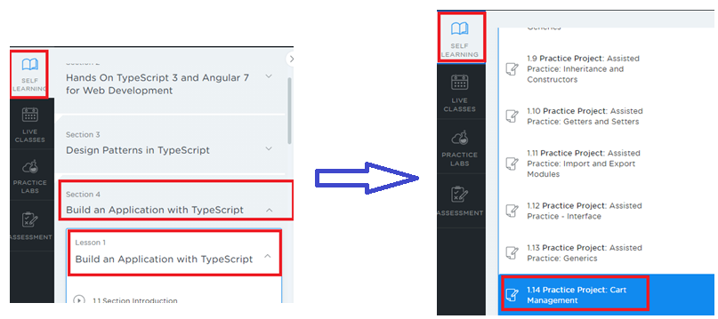
Project Description Location
Login to LMS & go to Program - Full Stack Web Developer – MEAN Stack
Under Course 3, Choose Phase 2 – Create websites using Front and Back-end frameworks
In Self Learning, Choose Section 4 Lesson 1, scroll down to the sub-section 1.14

Slide 3
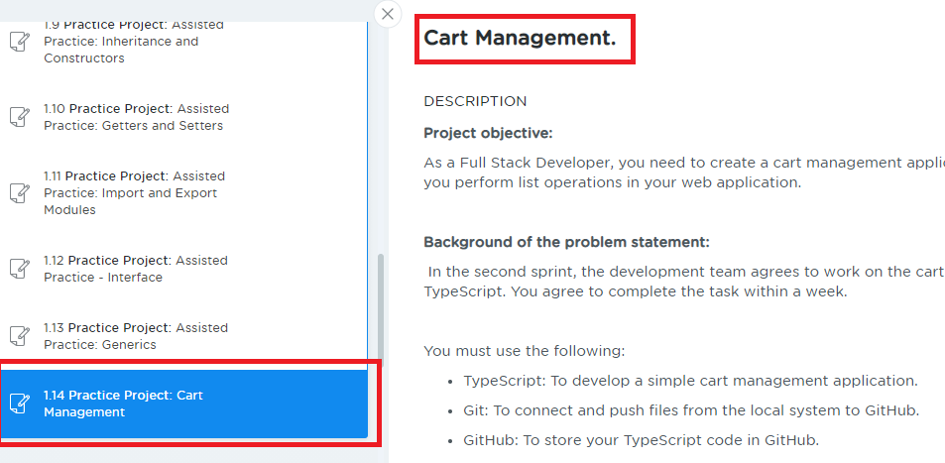
Project Description
Read the project description

Slide 4
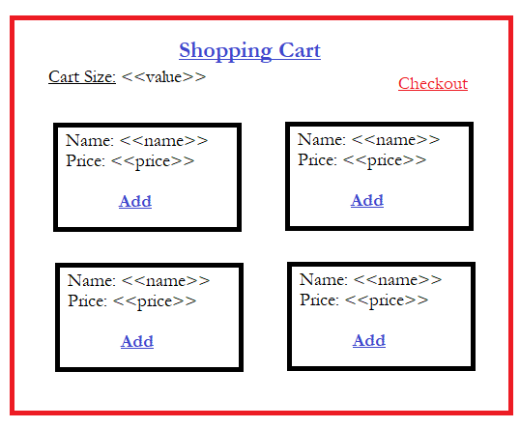
Project Implementation
Additional Implementation (Not Mandatory):
You can have an image to each item
You can have a delete button to delete the added product
You can have quantity to the item

Slide 5
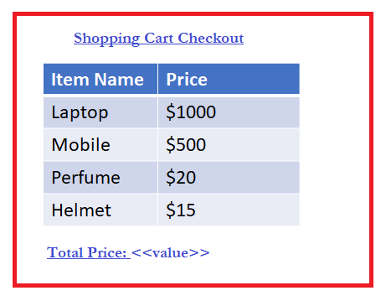
Project Implementation
Once you click on the checkout you can show the page which shows the list of items added in the cart with total price in a table as below
Additional Implementation (Not Mandatory):
You can show the quantity for each item if in case you have implemented the quantity feature
You can show the price based on the quantity

Slide 6
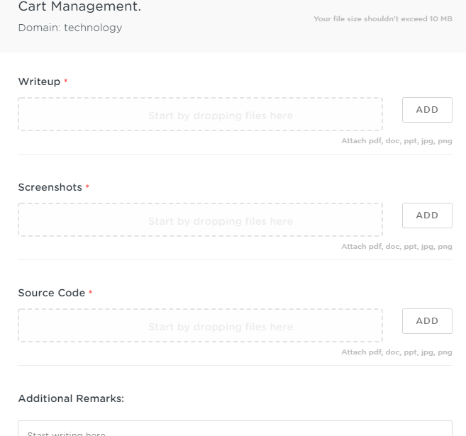
Project Submission Steps
After you click on submit in the project description you will get a window as below

Slide 7
Important things to consider
Write Up
Don’t push the document into the Git repository, use .gitignore file
Better create separate folder for the project inside the git repository
Mention the Git repo link in the document
Mention the folder name that has project in the document
Give brief information about the source code files to make us understand what is the purpose of the file in the document.
EX: index.html is the main page which has links to Home, Services, Contacts
EX: styles.css is the style sheet that is used to design web page
EX: myscripts.ts is the typescript code which has functions like search() to search the data

Slide 8
Important things to consider
Screenshot
Add the screen shot of the project output
You are allowed to add multiple screen shots in case required
Source Code
Wrap all the source codes like html, css, js, ts, etc in a zip
Upload the zip
If in case zip is not supported you can attach all source codes one by one
Note:
While pushing the project in Git repository you can have all your assignments and projects in a single repository
Create separate folders for each project in the Git repository, however you can mention these folder names in the document

Slide 9
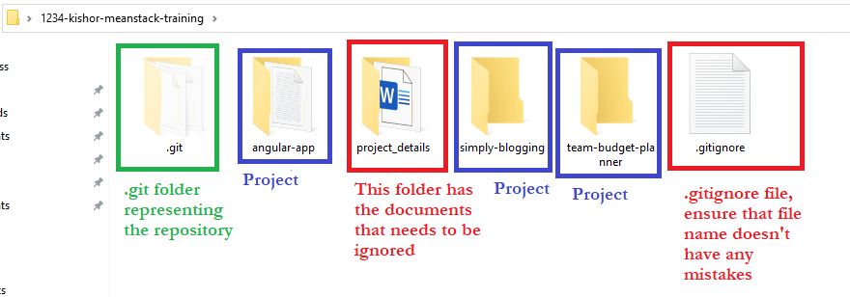
How to ignore document not to track in git
Create a folder in the repository with some name, e.g., project_details, keep all the documents inside this folder
Open .gitignore file and add the folder name entry as project_details/
Below is a screenshot of the local repository to understand where to keep .gitignore file, notice its inside the repository 1234-kishor-meanstack-training

Slide 10
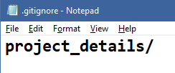
Adding the project_details folder entry inside .gitingore file
Open .gitignore file and add the folder project_details that has all the documents explaining each project
When you enter git status you can notice that project_details folder wouldn’t be tracked

